Slide 1

Verified Numerical Methods for Ordinary Differential Equations
Ariel E. Kellison¹ and Andrew W. Appel²
¹ Cornell University
² Princeton University
15th International Workshop on Numerical Software Verification (NSV ‘22), August 12th, 2022

Slide 2
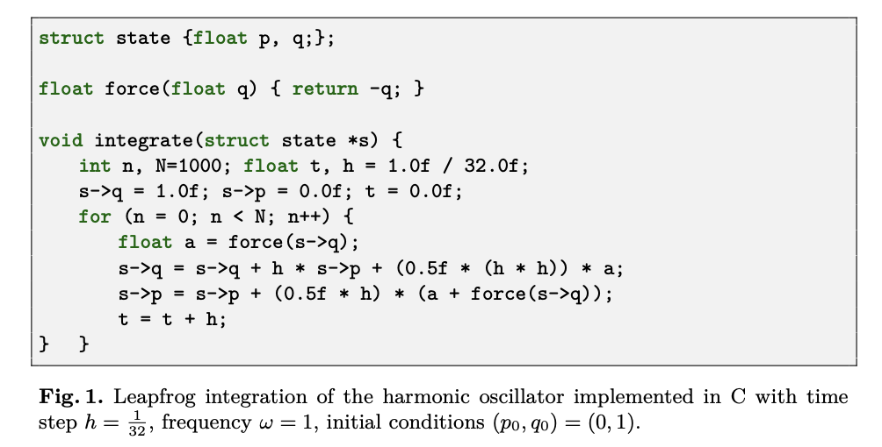


Verification task: prove ODE solver is accurate and correct.
$$\frac{dp}{dt} =−ω^{2}q \frac{dq}{dt}=p$$
Specification
Prove that the program correctly implements the specification.
Prove that the program accurately implements the specification.
Numerical Program

Slide 3
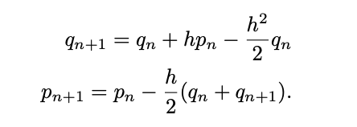
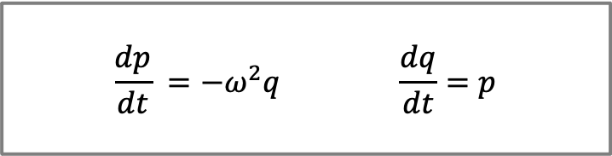
Verification task: prove ODE solver is accurate and correct.
$$\frac{dp}{dt} =−ω^{2}q \frac{dq}{dt}=p$$
Specification
Prove that the program correctly implements the specification.
Prove that the program accurately implements the specification.
Numerical Program

Slide 4

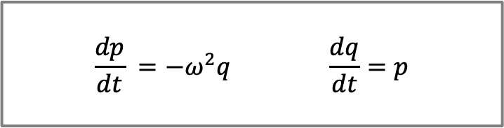
Verification Layers
High-Level Specification
Continuous System
Discretization error
$$\frac{dp}{dt} =−ω^{2}q \frac{dq}{dt}=p$$
Real Functional Model ($ℝ$)
Round-off error
Functional programs that implement the numerical method
Floating-Point Functional Model
Program correctly implements model
Numerical Program
Compiler correctness
Machine Language Program

Slide 5
Verification Structure
High-Level Specification
Continuous System
Use single logical framework to define specifications & models, and to prove theorems:
Coq is an interactive theorem prover that implements a higher-order dependently typed logic.
Compose theorems into a main accuracy & correctness theorem:
Discretization error
Real Functional Model ($ℝ$)
Round-off error
Floating-Point Functional Model
Program correctly implements model
Numerical Program
Machine language program correctly & accurately computes the high-level specification.
Compiler correctness
Machine Language Program

Slide 6
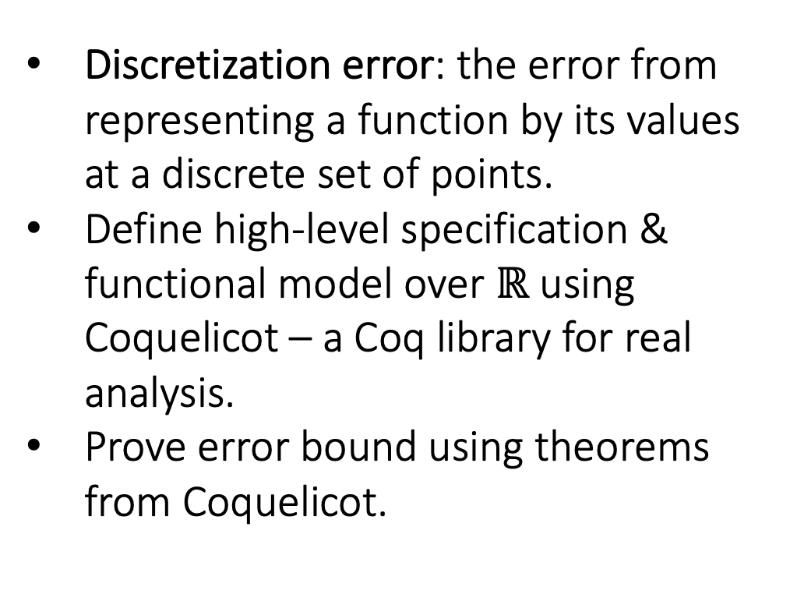
Verification Structure
High-Level Specification
Continuous System
Discretization error: the error from representing a function by its values at a discrete set of points.
Define high-level specification & functional model over $ℝ$ using Coquelicot – a Coq library for real analysis.
Prove error bound using theorems from Coquelicot.
Discretization error
Real Functional Model ($ℝ$)
Round-off error
Floating-Point Functional Model
Program correctly implements model
Numerical Program
Compiler correctness
Machine Language Program

Slide 7
Verification Structure
High-Level Specification
Continuous System
Round-off error: the difference between the result produced using exact arithmetic and the result produced using floating-point arithmetic.
Define functional model over floats using VCFloat – a Coq library for verified round-off error analysis.
VCFloat core uses Coq library Flocq – formal spec. of IEEE-754
Prove error bound using VCFloat & Coquelicot.
Discretization error
Real Functional Model ($ℝ$)
Round-off error
Floating-Point Functional Model
Program correctly implements model
Numerical Program
Compiler correctness
Machine Language Program

Slide 8

Verification Structure
High-Level Specification
Continuous System
Refinement proof: a proof that the program implements the floating-point functional model.
Proof uses Verified Software Toolchain (VST) – a higher-order logic for reasoning about C programs.
Discretization error
Real Functional Model ($ℝ$)
Round-off error
Floating-Point Functional Model
Program correctly implements model
Numerical Program
Compiler correctness
Machine Language Program

Slide 9
Verification Structure
High-Level Specification
Continuous System
Refinement proof: a proof that the program implements the floating-point functional model.
Proof uses Verified Software Toolchain (VST) – a higher-order logic for reasoning C programs.
Proved sound w.r.t the semantics of C used by the CompCert verified C compiler.
Any theorems proved with VST hold of assembly generated by CompCert.
Discretization error
Real Functional Model ($ℝ$)
Round-off error
Floating-Point Functional Model
Program correctly implements model
Numerical Program
Compiler correctness
Machine Language Program

Slide 10
Verification Structure
High-Level Specification
Continuous System
Use VST to compose theorems into a main accuracy & correctness theorem:
Discretization error
Real Functional Model ($ℝ$)
Round-off error
Machine language program correctly & accurately computes the high-level specification.
Floating-Point Functional Model
Program correctly implements model
Numerical Program
Compiler correctness
Machine Language Program

Slide 11

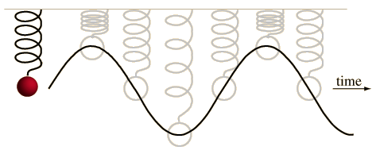
Model Problem:
simple harmonic oscillator
High-Level Specification
Continuous System
Discretization error
Real Functional Model ($ℝ$)
Round-off error
Floating-Point Functional Model
Program correctly implements model
Numerical Program
Compiler correctness
Machine Language Program

Slide 12

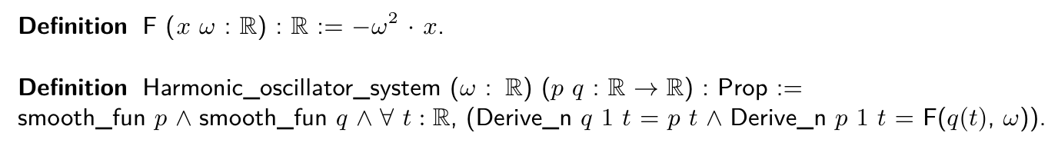
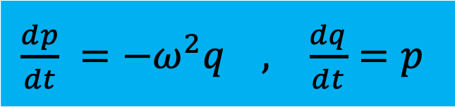
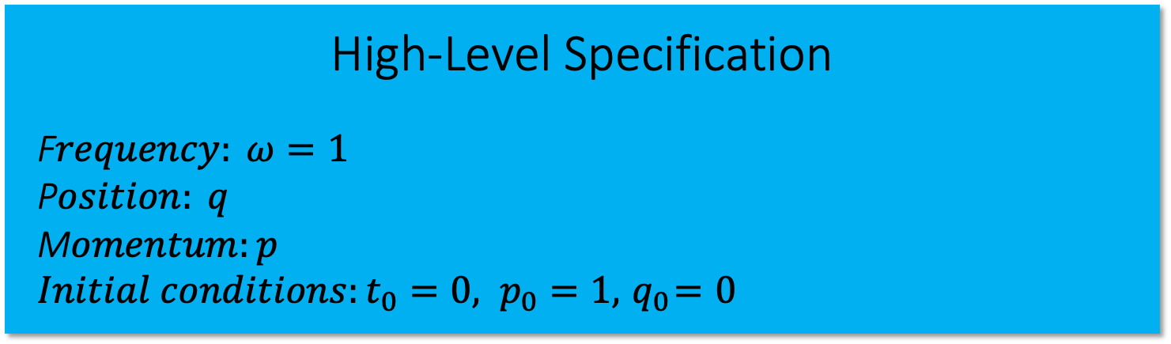
Model Problem:
simple harmonic oscillator
High-Level Specification
F$requency: ω=1$
P$osition: q$
M$omentum:p$
$Initial conditions:t_{0}=0, p_{0}=1,{ q}_{0}=0$
$\frac{dp}{dt} =−ω^{2}q , \frac{dq}{dt}=p$
*Provable property: ${∀t, \left\|(p(t),q(t))\right\|}_{2}={\left\|(p(t_{0}),q(t_{0}))\right\|}_{2}$

Slide 13
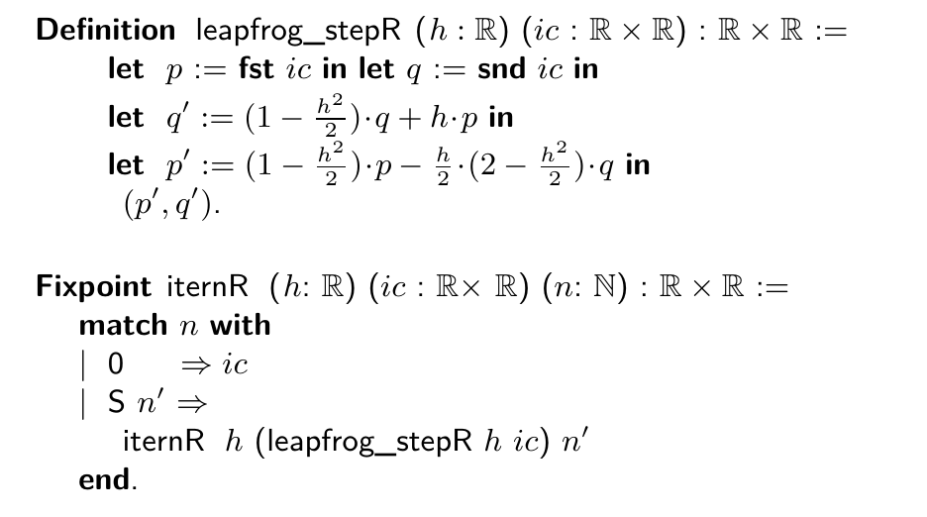
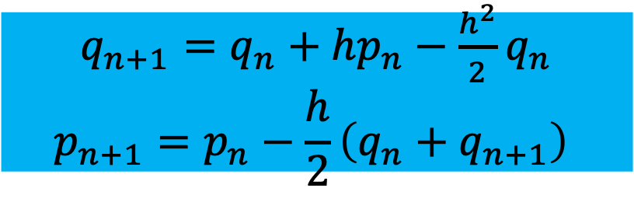
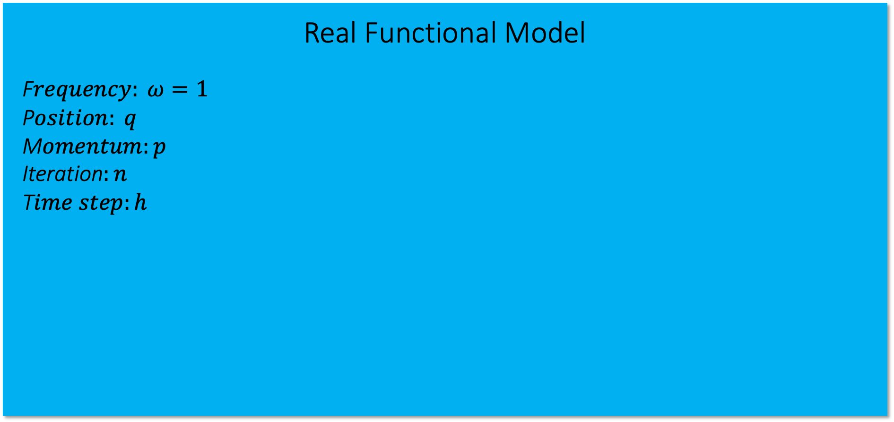
Model Problem:
simple harmonic oscillator
Real Functional Model
F$requency: ω=1$
P$osition: q$
M$omentum:p$
Iteration$:n$
T$ime step:h$
$q_{n+1}=q_{n}+hp_{n}−\frac{h^{2}}{2}q_{n}$
$$p_{n+1}=p_{n}−\frac{h}{2}\left(q_{n}+q_{n+1}\right)$$
“Leapfrog” integration
scheme

Slide 14
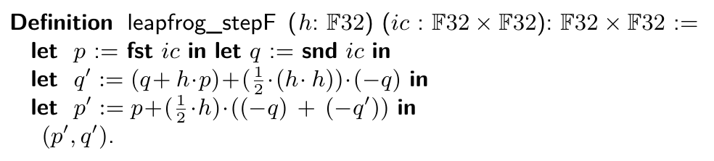
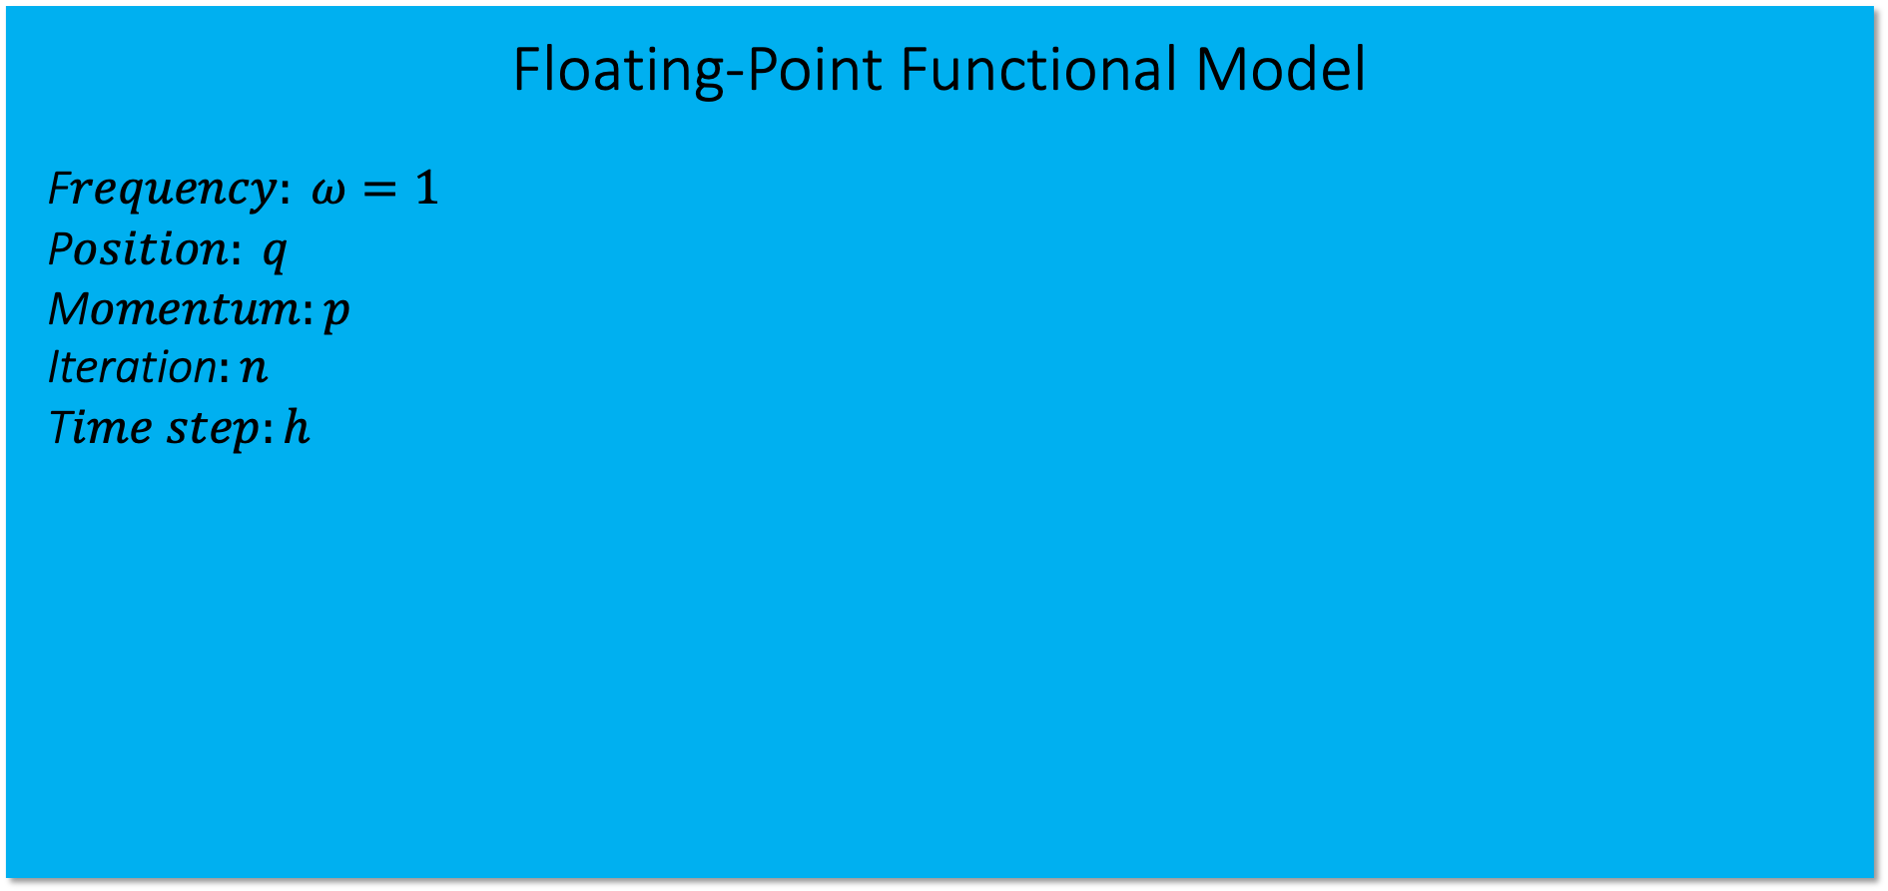
Model Problem:
simple harmonic oscillator
Floating-Point Functional Model
F$requency: ω=1$
P$osition: q$
M$omentum:p$
Iteration$:n$
T$ime step:h$
$q_{n+1}=q_{n}+hp_{n}−\frac{h^{2}}{2}q_{n}$
$$p_{n+1}=p_{n}−\frac{h}{2}\left(q_{n}+q_{n+1}\right)$$
“Leapfrog” integration
scheme

Slide 15
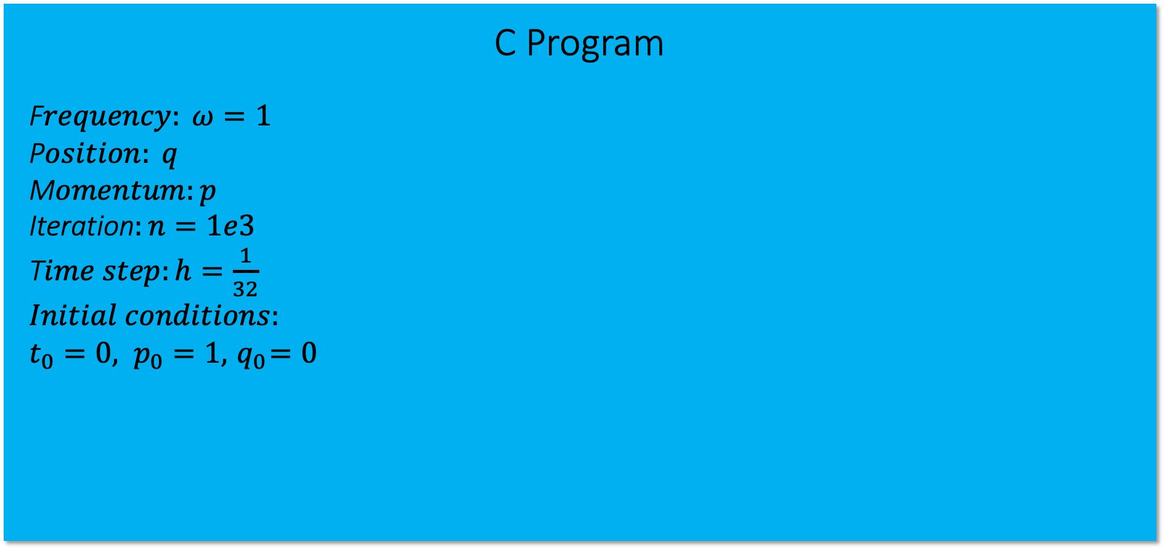
Model Problem:
simple harmonic oscillator
C Program
F$requency: ω=1$
P$osition: q$
M$omentum:p$
Iteration$:n=1e3$
T$ime step:h=\frac{1}{32}$
$Initial conditions:$
$t_{0}=0, p_{0}=1,{ q}_{0}=0$

Slide 16
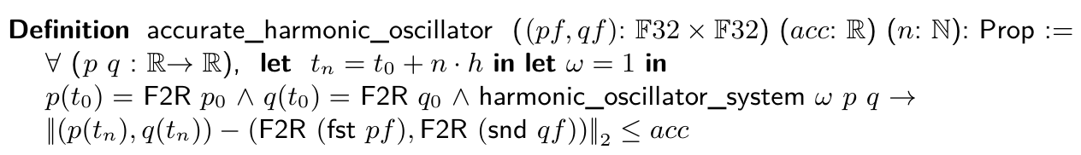
Main Theorem
Accuracy – prove that the functional model is correct with respect to the high-level spec. : accurate_harmonic_oscillator = true with acc=0.038 after 1e3 steps.

Slide 17
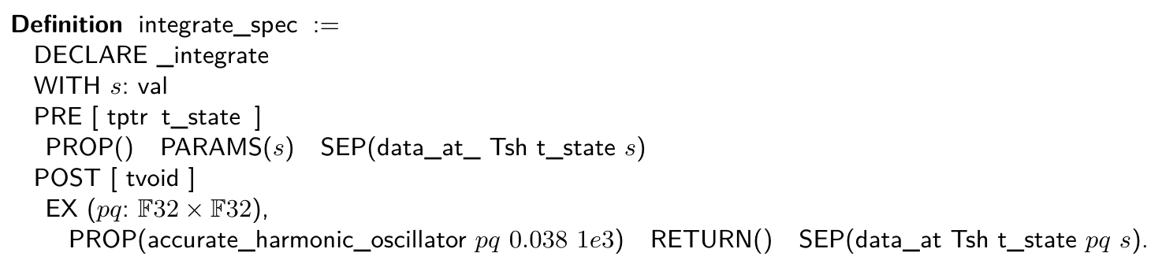
Main Theorem
Accuracy – prove that the functional model is correct with respect to the high-level spec. : accurate_harmonic_oscillator = true with acc=0.038 after 1e3 steps.
Correctness – the C function integrate satisfies the specification integrate_spec .
PRE: the function parameter contains the value s and the “data at” that location is uninitialized.
POST: stored at address s – a pair pq of single-precision values floating-point values that solves ODE to within 0.038 of true solution after 1e3 time steps.

Slide 18
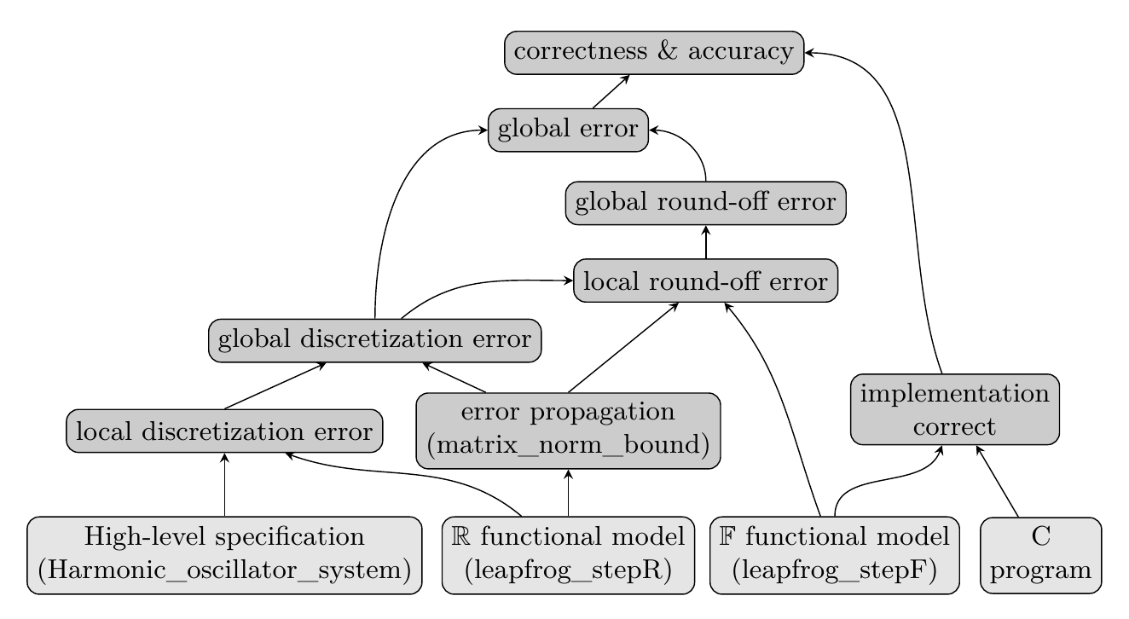
Proof Outline

Slide 19
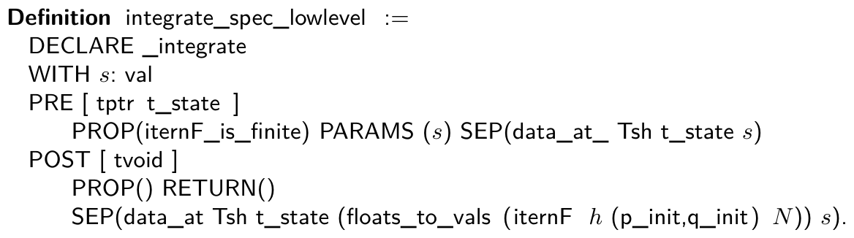
Implementation Correctness
The C function integrate satisfies integrate_spec_low_level.
PRE: the function parameter contains the value s; the “data at” that location is uninitialized and finite (not a NaN or infinity).
POST: the value (iternF h (p_init, q_init) N) will be stored at location s.

Slide 20

Proof Outline

Slide 21
Proof Outline

Slide 22
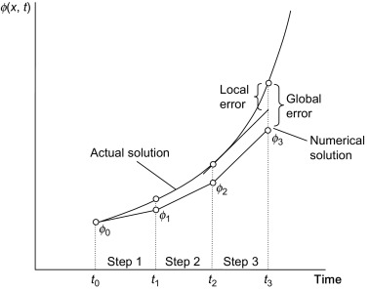
Local & global error
Local error: error after single iteration on the same input.
Global error: error over the entire time interval.

Slide 23
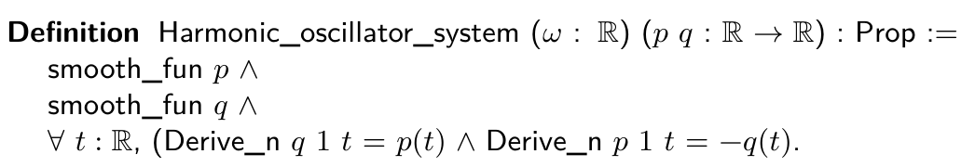
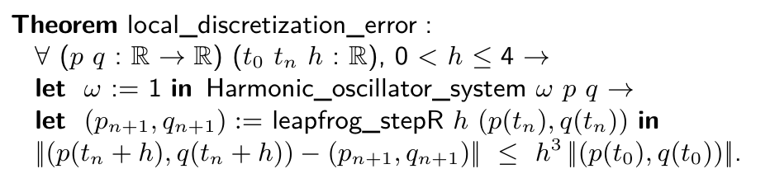
Local discretization error
Discretization error: the error from representing a function by its values at a discrete set of points.
High-Level Specification
Real Functional Model

Slide 24
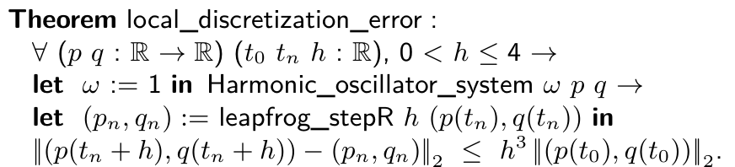
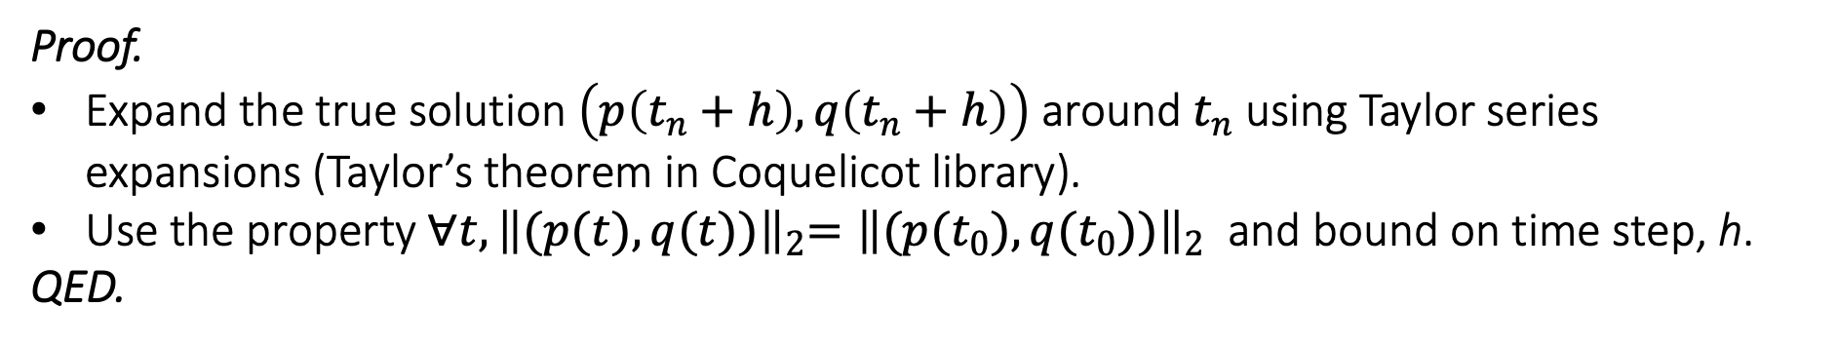
Local discretization error
Proof.
Expand the true solution $\left(p\left(t_{n}+h\right),q\left(t_{n}+h\right)\right)$ around $t_{n}$ using Taylor series expansions (Taylor’s theorem in Coquelicot library).
Use the property ${∀t, \left\|(p(t),q(t))\right\|}_{2}={\left\|(p(t_{0}),q(t_{0}))\right\|}_{2}$ and bound on time step, h.
QED.

Slide 25
Proof Outline

Slide 26
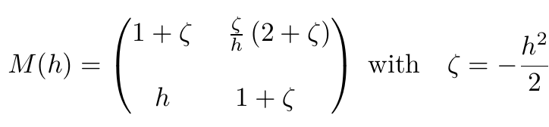
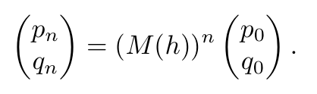
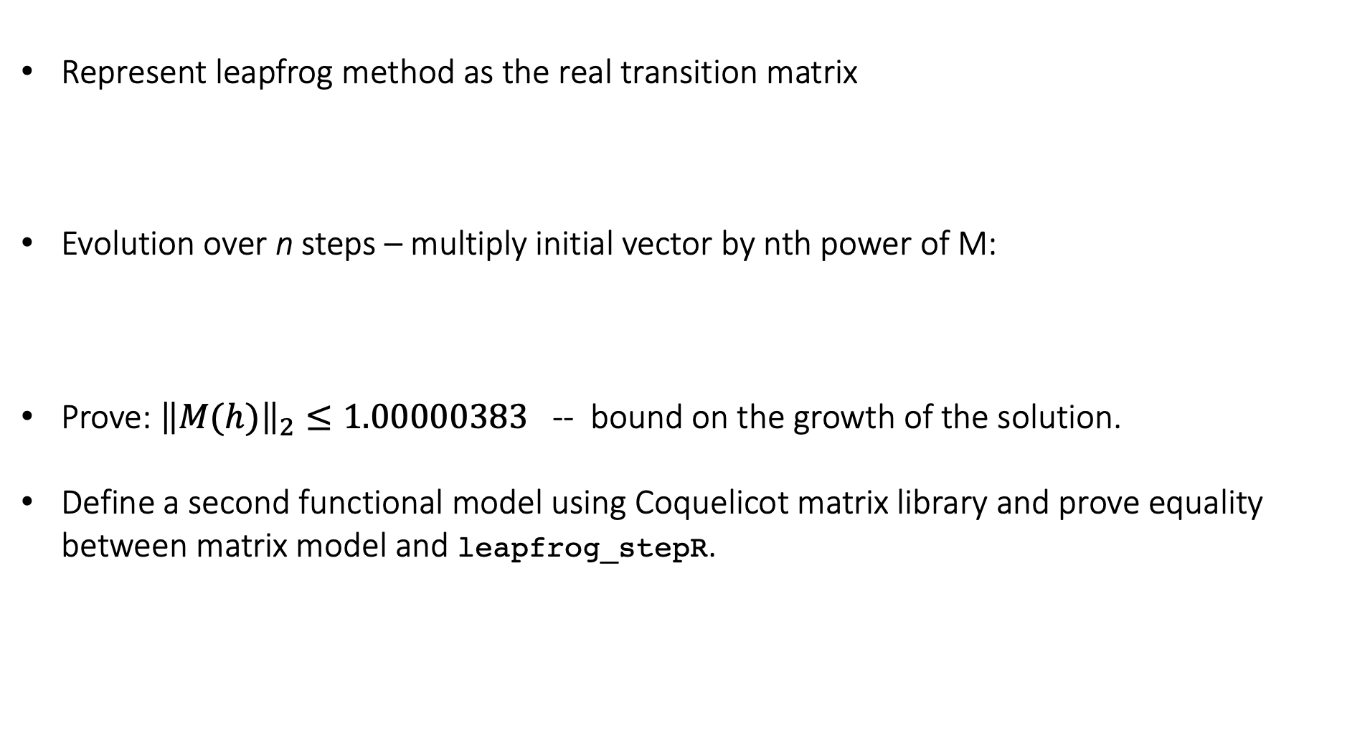
Error propagation
Represent leapfrog method as the real transition matrix
Evolution over n steps – multiply initial vector by nth power of M:
Prove: ${\left\|M(h)\right\|}_{2}≤1.00000383$ -- bound on the growth of the solution.
Define a second functional model using Coquelicot matrix library and prove equality between matrix model and leapfrog_stepR.

Slide 27
Proof Outline

Slide 28
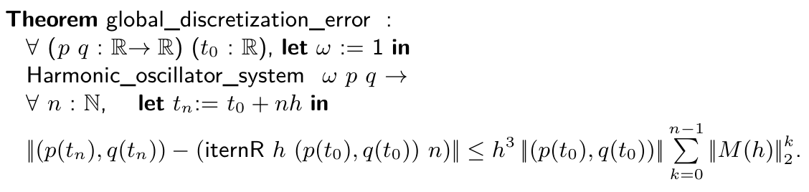
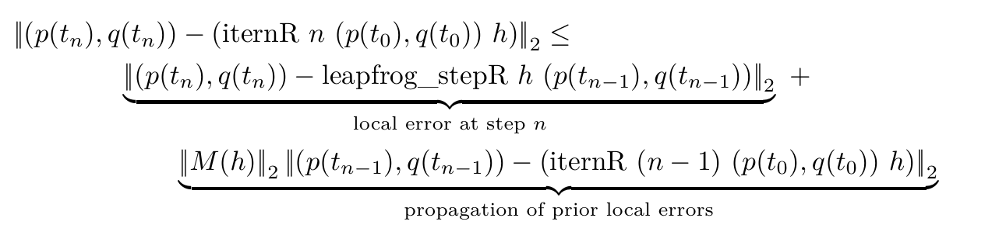
Global discretization error
Proof.
Apply triangle inequality; use equality between matrix model and leapfrog_stepR.
Use local discretization error theorem to upper bound local error.
QED.

Slide 29
Proof Outline

Slide 30
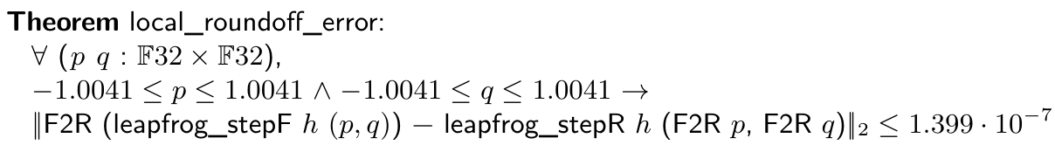
Local round-off error
Round-off error: the difference between the result produced using exact arithmetic and the result produced using floating-point arithmetic.
Floating-point Functional Model
Real Functional Model

Slide 31
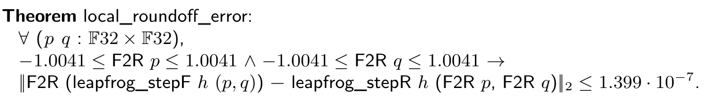
Local round-off error
Proof.
Proof is mostly automatic – using VCFloat and Coq Interval package.
VCFloat generates proof obligations for absence of underflow and overflow – these follow from bounds in premise on p and q.
QED.

Slide 32
Local round-off error
Proof.
Proof is mostly automatic – using VCFloat and Coq Interval package.
VCFloat generates proof conditions for absence of underflow and overflow – these follow from bounds in premise on p and q.
QED.
How to derive premise $−1.0041 ≤p,q ≤1.0041?$

Slide 33
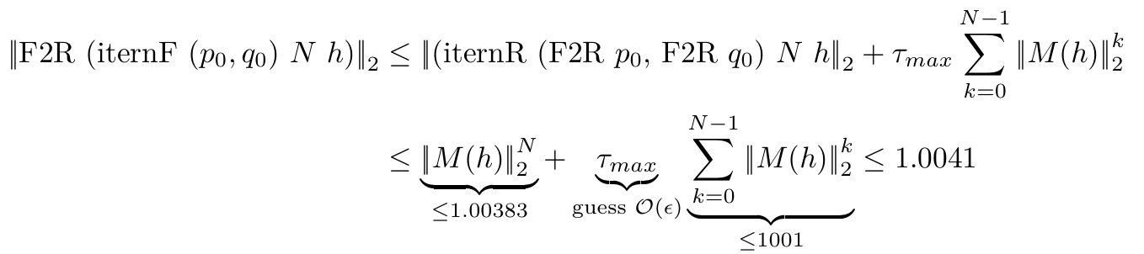
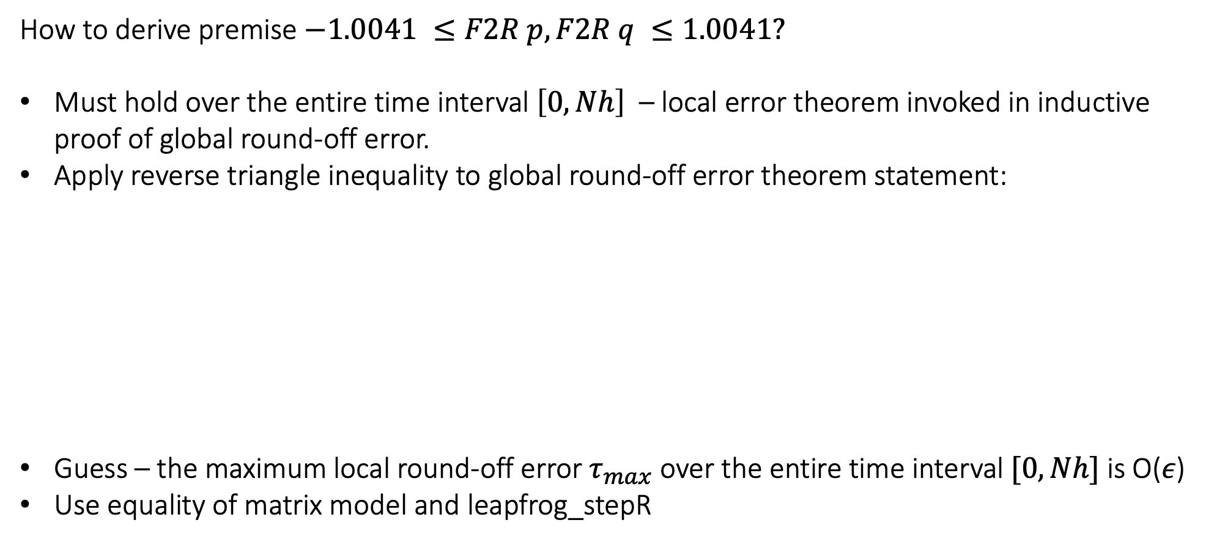
Local round-off error
How to derive premise $−1.0041 ≤F2R p,F2R q ≤1.0041?$
Must hold over the entire time interval $\left[0,Nh\right]$ – local error theorem invoked in inductive proof of global round-off error.
Apply reverse triangle inequality to global round-off error theorem statement:
Guess – the maximum local round-off error $τ_{max}$ over the entire time interval $[0,Nh]$ is O($ε$)
Use equality of matrix model and leapfrog_stepR

Slide 34
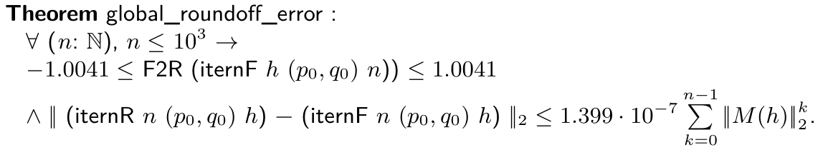
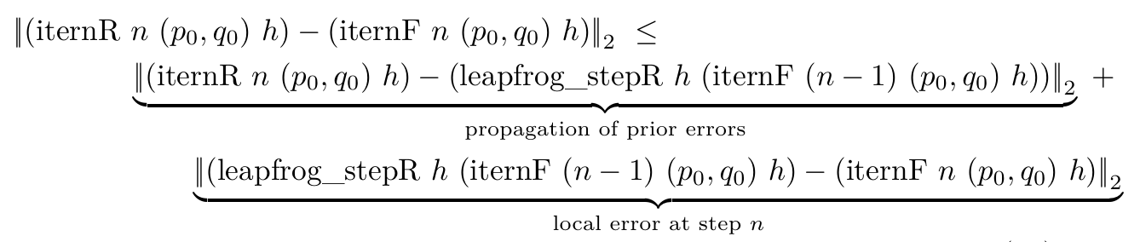
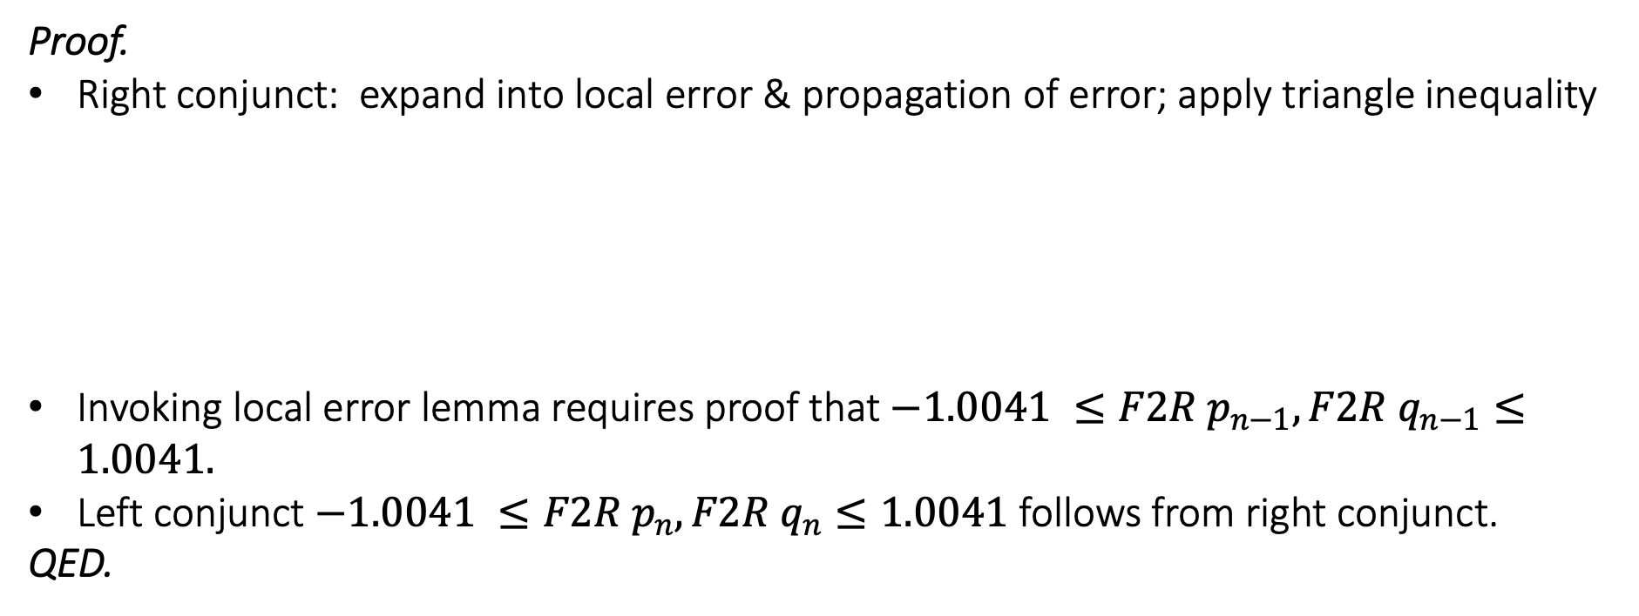
Global round-off error
Proof.
Right conjunct: expand into local error & propagation of error; apply triangle inequality
Invoking local error lemma requires proof that $−1.0041 ≤{F2R p}_{n−1},{F2R q}_{n−1}≤1.0041.$
Left conjunct $−1.0041 ≤{F2R p}_{n},{F2R q}_{n}≤1.0041$ follows from right conjunct.
QED.

Slide 35
Proof Outline

Slide 36
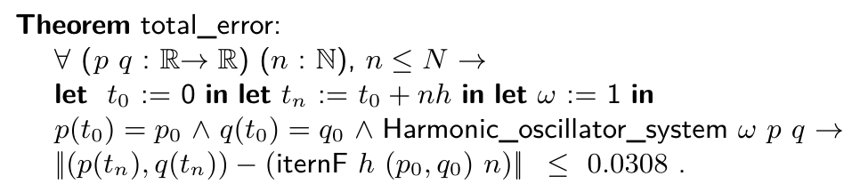
Total global error
Proof.
Expand into global round-off error and global discretization error terms;
Apply triangle inequality;
Invoke global round-off error and discretization error theorems.
QED.

Slide 37
Main Theorem
Accuracy – prove that the functional model is correct with respect to the high-level spec. : accurate_harmonic_oscillator = true with acc=0.038 after 1e3 steps.
Correctness – the C function integrate satisfies the specification integrate_spec .
PRE: the function parameter contains the value s and the “data at” that location is uninitialized.
POST: stored at address s – a pair pq of single-precision values floating-point values that solves ODE to within 0.038 of true solution after 1e3 time steps.

Slide 38
Proof Outline

Slide 39

Related Work
High-Level Specification
Continuous System
Prove existence and uniqueness of solutions to IVPs for ODEs.
Perform error analysis on 1D Euler method.
Rounding error analysis is not sound w.r.t IEEE model – guaranteed by VCFloat.
Discretization error and round-off error are treated uniformly – proofs are not modular.
Immler and Hözel, Numerical Analyis of ODEs in Isabelle/HOL, 2012.
Discretization error
Real Functional Model ($ℝ$)
Round-off error
Floating-Point Functional Model
Program correctly implements model
Numerical Program
Compiler correctness
Machine Language Program

Slide 40
Related Work
High-Level Specification
Continuous System
Verifies C program implementing a second-order finite difference scheme for solving the 1D acoustic wave equation.
Model problem is PDE – could be generalized to ODE.
Derive a total error theorem that composes round-off & disc. error.
Use Frama-C – unlike VST has no soundness theorem w.r.t semantics of C.
Boldo et. al, A Mechanized Proof from PDE to actual program, 2014.
Discretization error
Real Functional Model ($ℝ$)
Round-off error
Floating-Point Functional Model
Program correctly implements model
Numerical Program
Compiler correctness
Machine Language Program

Slide 41
Related Work
High-Level Specification
Continuous System
Boldo et. al, Round-off error analysis of explicit one step numerical integration methods, 2017.
Analyze the round-off errors of Runge-Kutta methods applied to linear 1D initial values problems (IVPs).
Local error bound derived using Gappa; global error proof done outside mechanized logical framework.
Discretization error
Real Functional Model ($ℝ$)
Round-off error
Floating-Point Functional Model
Program correctly implements model
Numerical Program
Compiler correctness
Machine Language Program

Slide 42
Conclusion & Future Work
High-Level Specification
Continuous System
First end-to-end verification of a numerical method for an ODE.
Verification encapsulated in one main, machine-checked theorem.
Assumes only soundness of operational semantics of C and of the Flocq library spec. of IEEE.
Accuracy: discretization error
Intermediate Specification
Discrete algorithm (exact arithmetic)
Accuracy: round-off error
Low-level Specification
Discrete algorithm (floating-point)
Functional correctness
Numerical Program
Compiler correctness
Machine Language Program

Slide 43
Conclusion & Future Work
Automation is needed for…

Slide 44

Acknowledgements
This material is based upon work supported by the U.S. Department of Energy, Office of Science, Office of Advanced Scientific Computing Research, Department of Energy Computational Science Graduate Fellowship under Award Number DE-SC0021110.
Thanks for listening!

